Slide 1
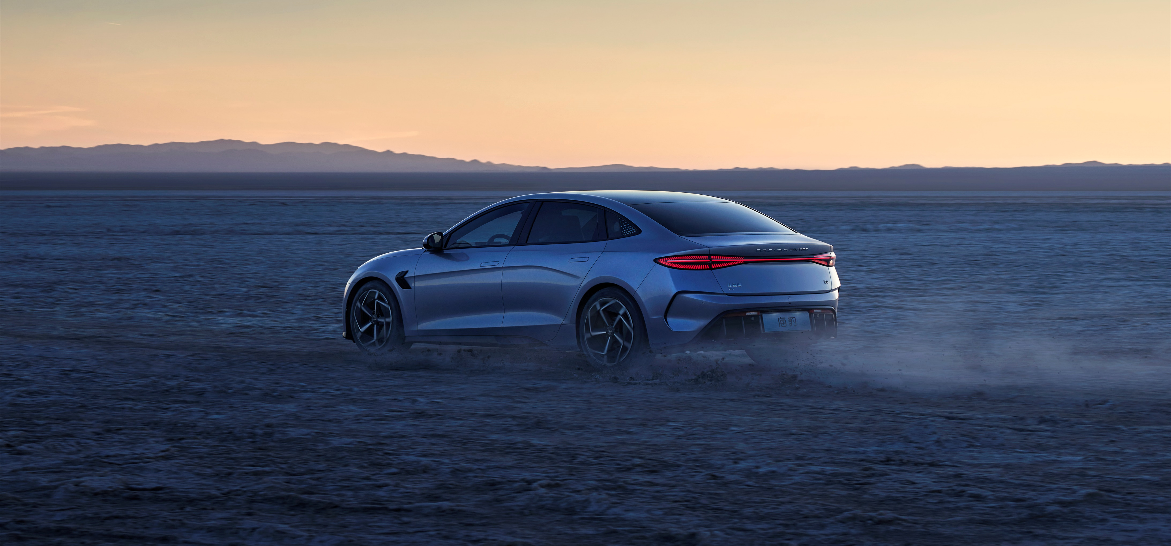
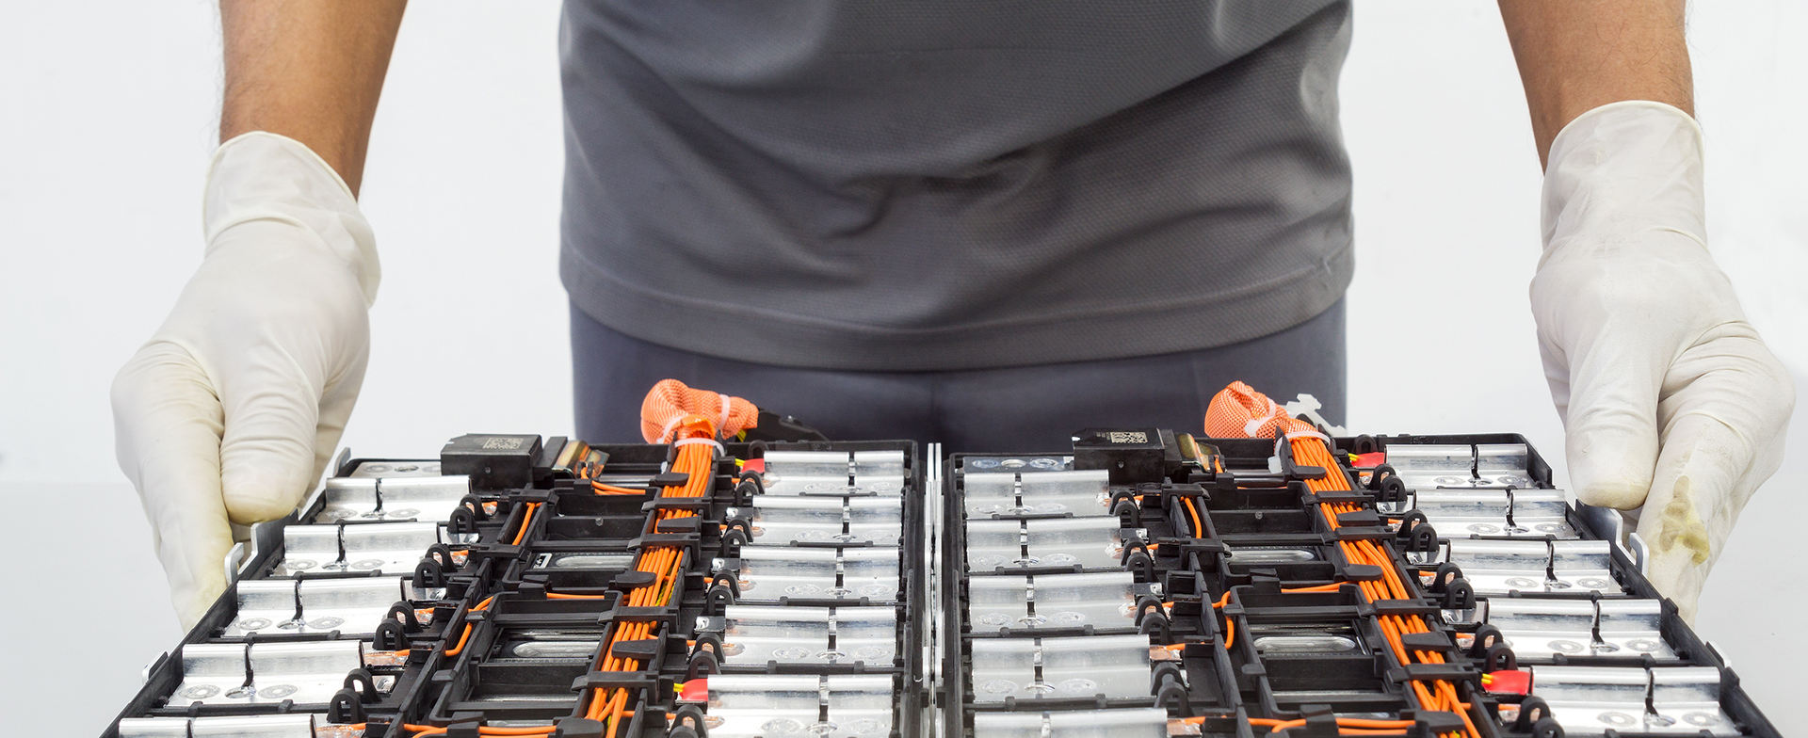
Handling Price Objections: Creating and Selling Value Over Price

Slide 2
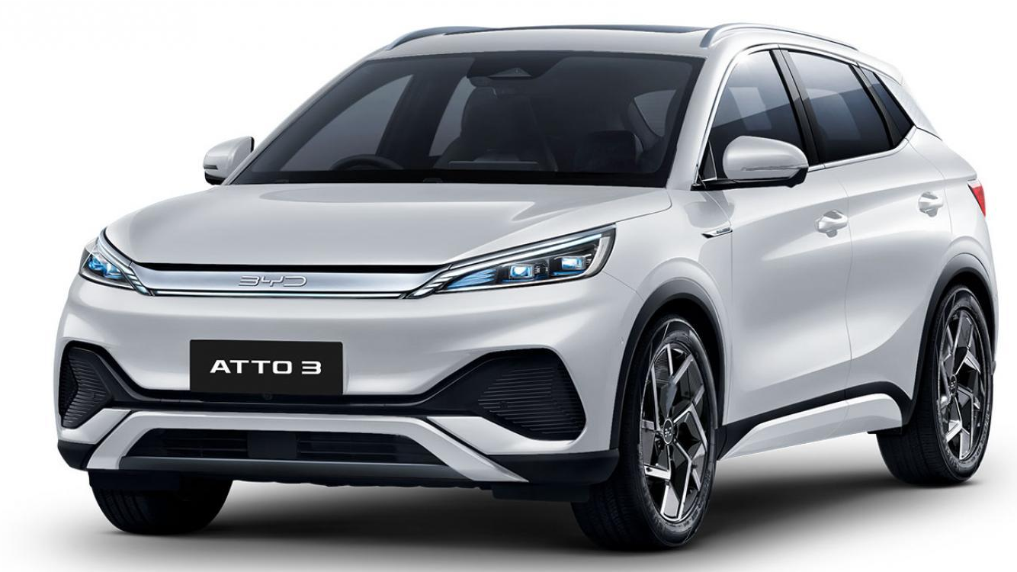
Overview: This session is designed to equip Sales Executives with the skills and techniques needed to effectively handle price objections by focusing on creating value with the BYD brand and product lineup.
The Importance of Handling Price Objections
Why Customers Focus on Price
The Role of the Sales Executive in Shaping Perceptions
Objectives
Learn to Shift the Conversation from Price to Value
Master Techniques for Addressing Price Objections
Understand the Expected Outcomes of Successful Objection Handling

Slide 3

Understanding Customer Concerns: Let’s explore the real reasons behind price objections and how effective communication can turn challenges into opportunities.
Why Customers Might Object to Price
Budget Constraints
Comparing with Competitors
Lack of Understanding of the Brand & Vehicle's Value
Importance of Empathy and Listening
Acknowledging Customer Concerns
Utilize APAC for Objection Handling
Building Trust Through Active Listening

Slide 4
Creating and Selling Value Over Price: emphasizing key elements can shift the conversation from cost to lasting satisfaction and peace of mind.
What Does "Value Over Price" Mean?
Emphasizing Benefits and Features Instead of Cost
Showing How the Vehicle Meets the Customer's Needs
Key Elements of Value to Highlight
Quality and Reliability: BYD vehicles are built to last, ensuring long-term satisfaction.
After-Sales Service: Our comprehensive service packages ensure your vehicle is always in top condition.
Total Ownership Experience: Less maintenance, less operational costs = more savings to customers. You’re also investing in peace of mind with our excellent customer service and support.
Example Responses to Use
"I understand your concern about price, but let me share why this vehicle is a smart investment for the long term.“
"This vehicle offers advanced safety features and technology that others in this range don't provide, making it a better value overall.“
"Consider the cost of ownership, not just the purchase price. With our extended warranties and service packages, you'll save more in the long run."

Slide 5
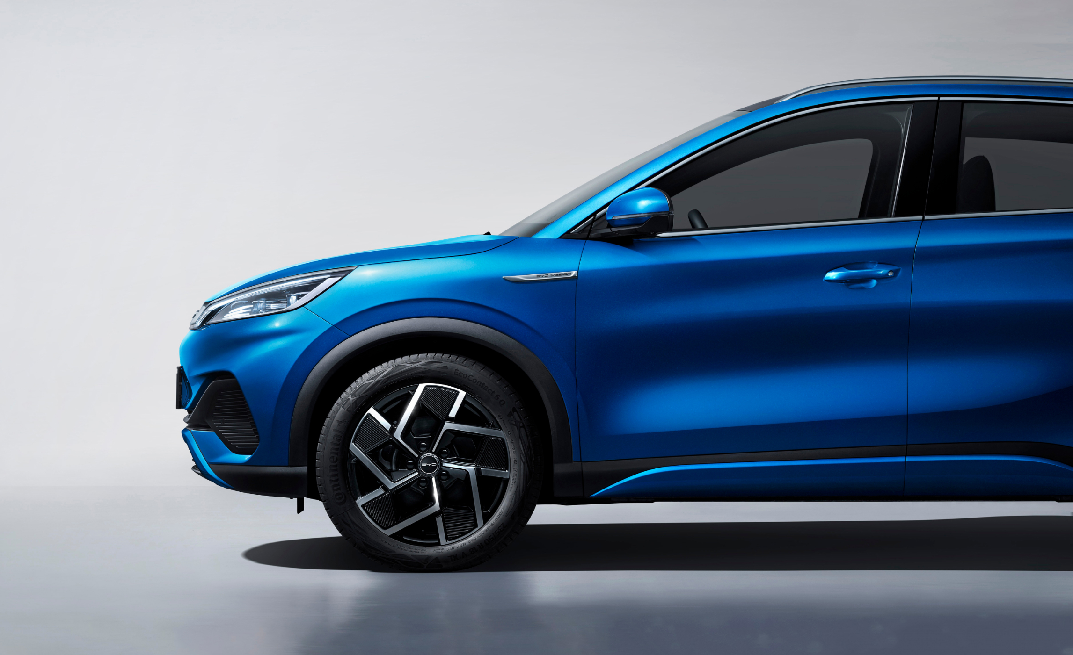
Techniques for Effective Objection Handling: It isn’t just about knowing the right responses—it's about connecting with your customers.
Techniques for Effective Objection Handling
Building Rapport Early in the Conversation
How: Start with a friendly greeting, ask open-ended questions, and show genuine interest in the customer's needs.
Why: Establishing trust early makes it easier to discuss value.
Using Stories and Testimonials
How: Share examples of satisfied customers who saw the long-term value.
Why: Stories can make abstract concepts of value more tangible.
Offering Alternatives
How: Suggest different models, payment plans, or packages that can align with the customer’s budget.
Why: Flexibility can lead to compromise, making it easier for the customer to see the value.

Slide 6
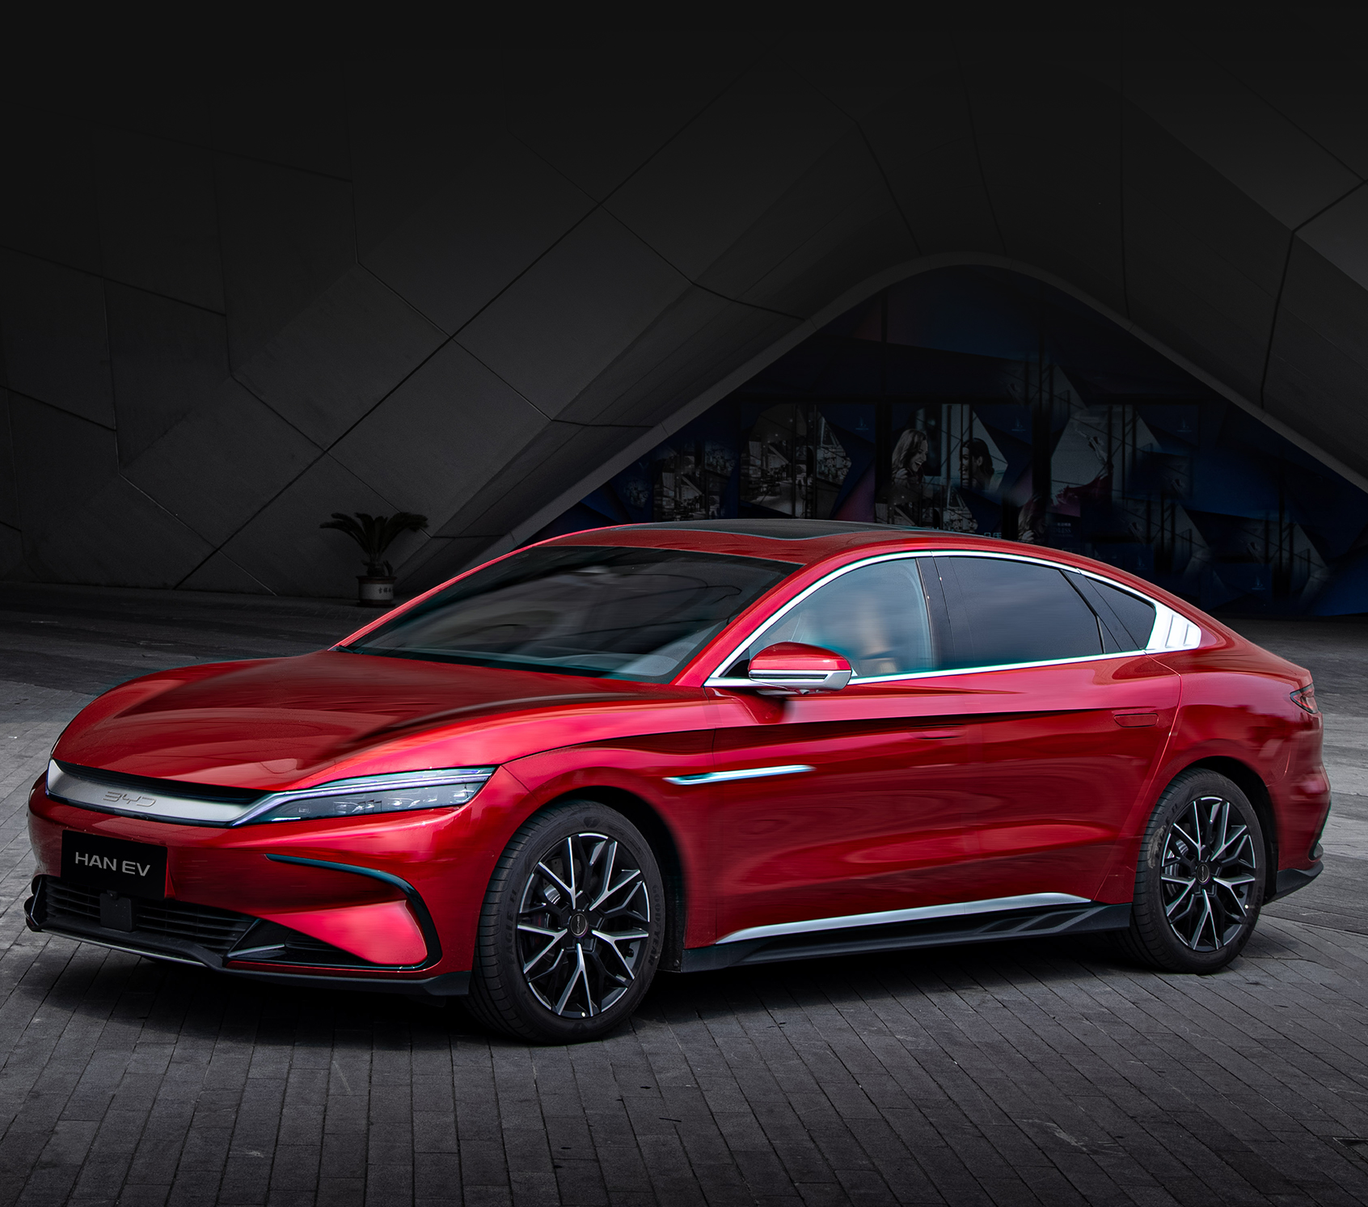
Common Price Objections and How to Handle Them: Putting your expertise to work – utilize our best practice when handling objections.
Examples – Objection Handling
Objection: "I found a similar car at a lower price elsewhere."
Response: "That’s understandable. However, when you consider the added value of our standard features, service packages, resale value, and the reliability of our vehicles, you'll see that this is a better long-term investment."
Objection: "The price is above my budget."
Response: "I understand budget is important. Let’s look at how we can make this work for you with financing options or by discussing vehicles that might better meet your needs while still offering the same value.“
Objection: "Why is this car more expensive than others I've looked at?“
Response: "This model includes premium features and safety technologies that are not standard in other vehicles. It’s not just about getting a car; it’s about getting peace of mind and a superior driving experience."

Slide 7
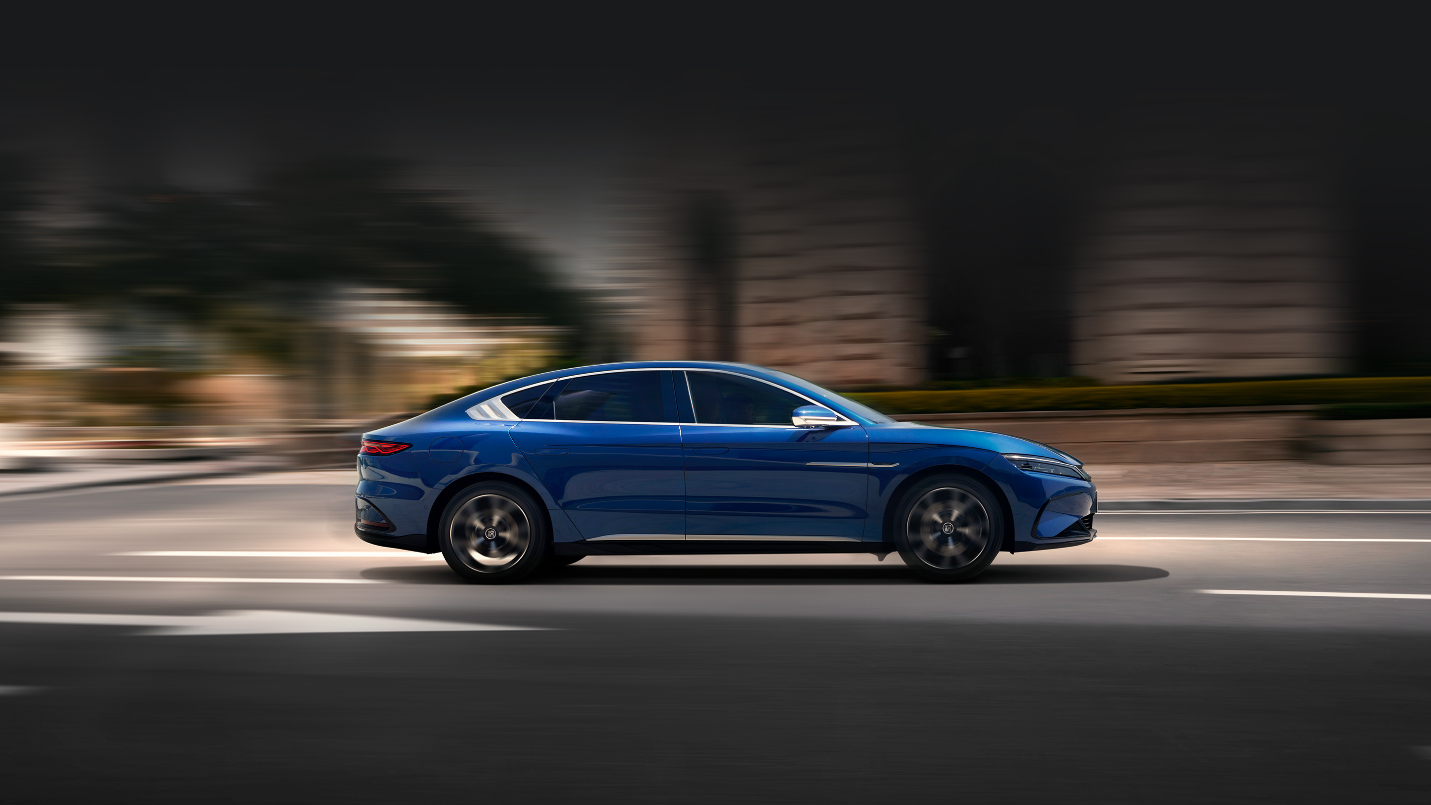
BYD Trims & Pricing

Slide 8
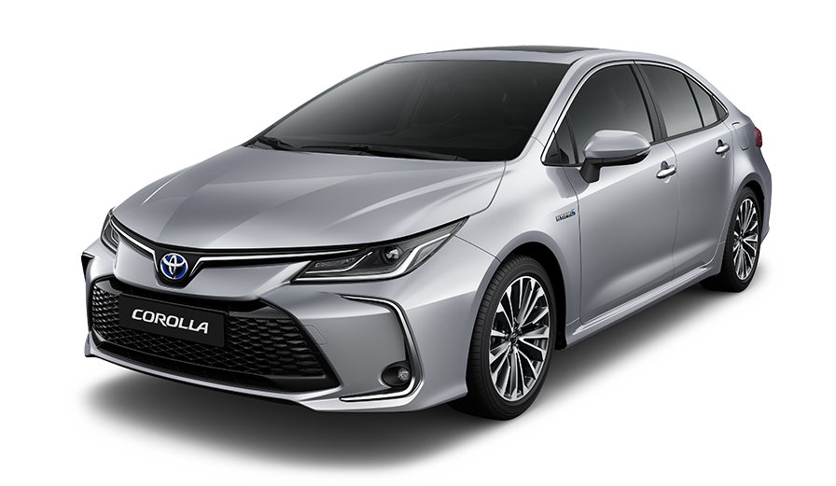
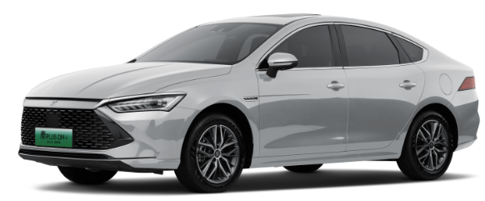
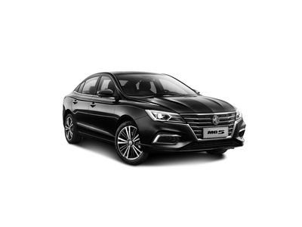
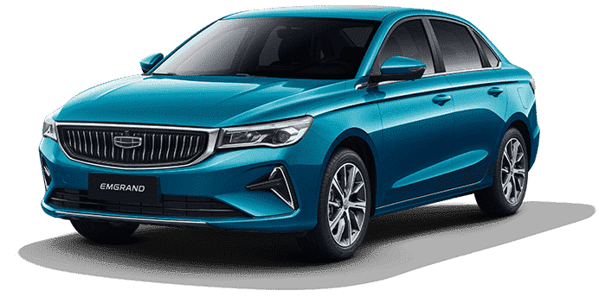
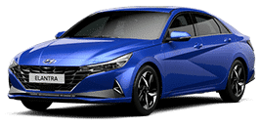
Qin Plus main competitors in the C-Sedan Segment.
Corolla
ICE / FWD
Starting Price – AED 74,900 Market Share – 20%
Corolla HEV
HEV / FWD
Starting Price – AED 87,900 Market Share – 17%
MG 5
ICE / 1.5L
Starting Price – AED 47,874 Market Share – 22%
BYD Qin Plus Comfort
PHEV / FWD / Battery Capacity 8kWh
Price – AED 75,900 / SoS Dec 2024
BYD Qin Plus Design
PHEV / FWD / Battery Capacity 8kWh
Price – AED 81,900 / SoS Dec 2024
BYD Qin Plus Premium
PHEV / FWD / Battery Capacity 18kWh
Price – AED 90,900 / SoS April 2024
MG 5 GT
ICE / 1.5T
Starting Price – AED 62,519 Market Share – 9%
C-Sedan Segment Price Ladder
Market Share
Geely Emgrand GS
ICE / 1.5L
Starting Price – AED 57,900 Market Share – 4%
HEV
Premium
HEV
Other
Elantra
Corolla
Geely Emgrand GK
ICE / 1.5L
Starting Price – AED 63,500 Market Share – <1%
Design
Corolla
MG GT
Comfort
MG GT
GK
Corolla
Elantra
1%
MG GT
MG 5
Elantra
Hyundai Elantra
ICE / FWD / 1.6L
Starting Price – AED 75,000 Market Share – 1%
MG 5
GS
Geely Emgrand
MG 5
MG 5
Hyundai Elantra N
HEV / FWD / 2.0T
Starting Price– AED 102,000 Market Share – <1%
Qin Plus
Primary Surrogate
Toyota Corolla
MG
Geely Emgrand
Hyundai Elantra
Source: MEAC Report, Prices incl 5% VAT

Slide 9
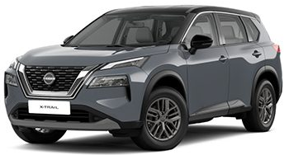
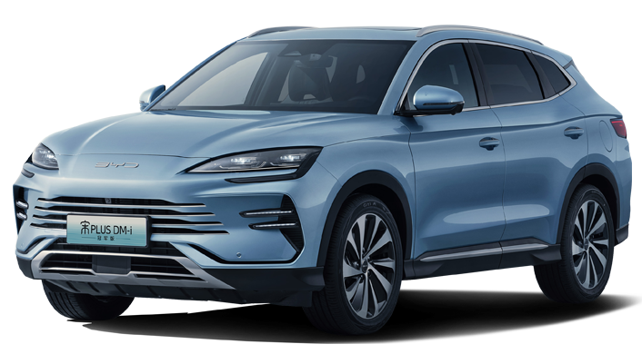
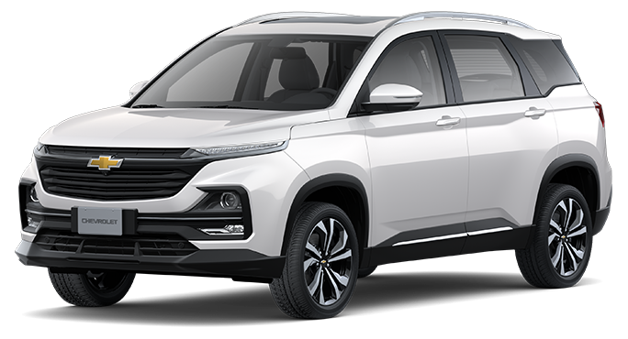
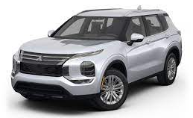
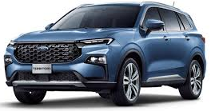
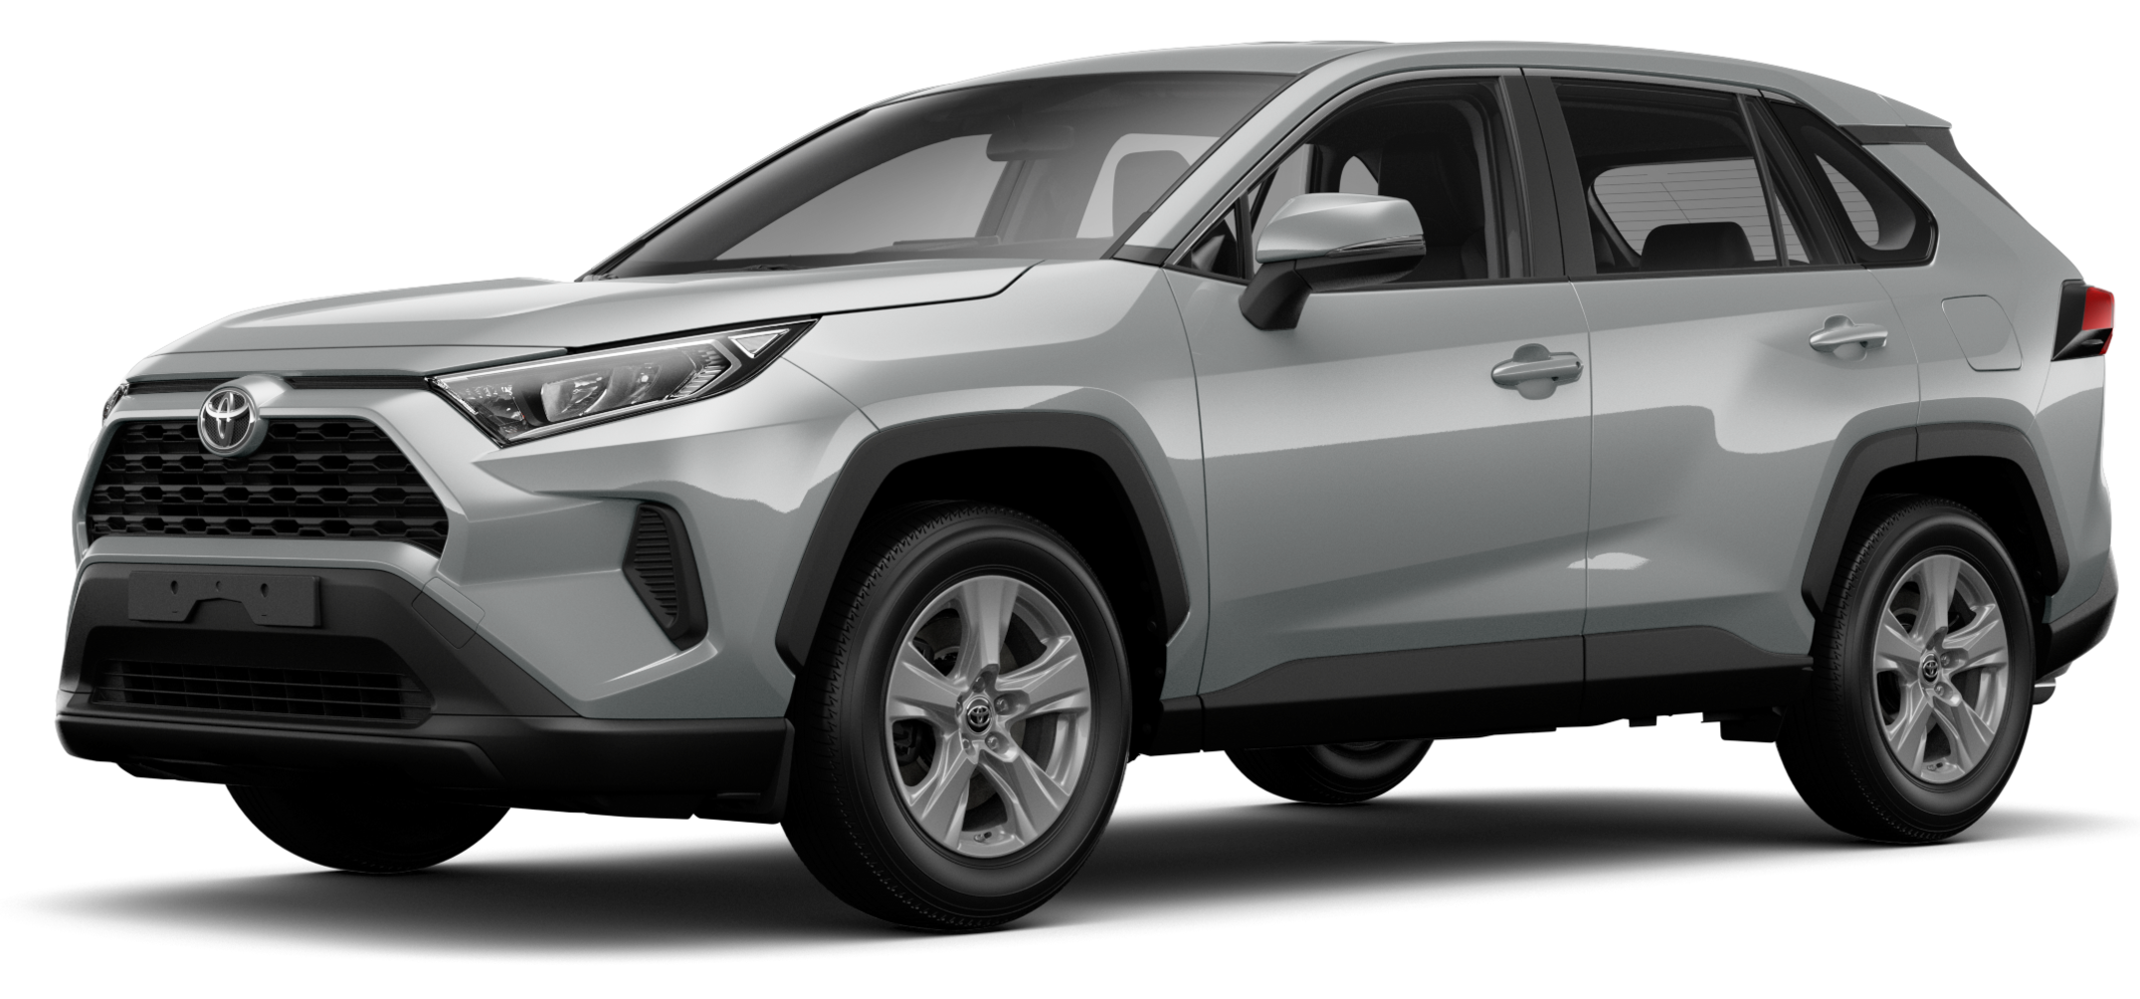
Song Plus main competitors in the C-SUV Segment.
X-Trail
ICE / 2.5L
Starting Price – AED 99,900 Market Share – 11%
Captiva
ICE / 1.5L
Starting Price – AED 74,900 Market Share – 10%
BYD Song Plus Design
PHEV / FWD / Battery Capacity 18.3kWh
Price – AED 118,900 / SoS May 2024
BYD Song Plus Premium
PHEV / AWD / Battery Capacity 18.3kWh
Price – AED 143,900 / SoS May 2024
Outlander
ICE / FWD / 2.5L
Starting Price – 100,000 Market Share – 9%
C-SUV Segment Price Ladder
Market Share
Premium
HEV
X-Trail
133,000
Captiva
Territory
ICE / FWD / 1.8T
Starting Price – AED 106,900 Market Share – 5%
124,000
HEV
Design
108,500
Other
Outlander
Territory
RAV4
ICE / FWD / 2.5L
Starting Price – AED 99,900 Market Share – 10%
RAV4
Song Plus
X-Trail
Captiva
Outlander
Territory
RAV4
Source: MEAC Report 2024, Prices incl 5% VAT

Slide 10
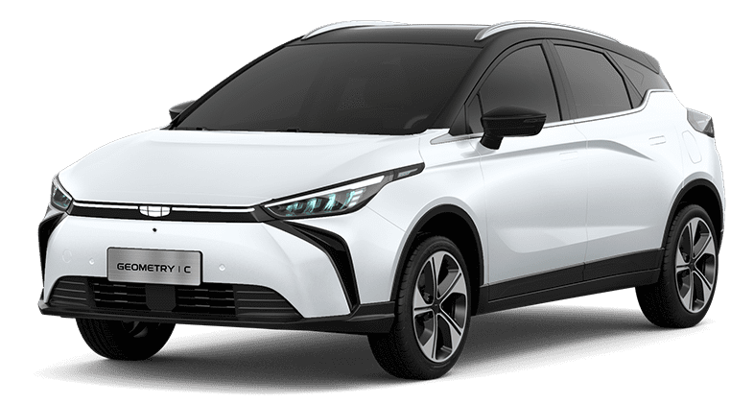
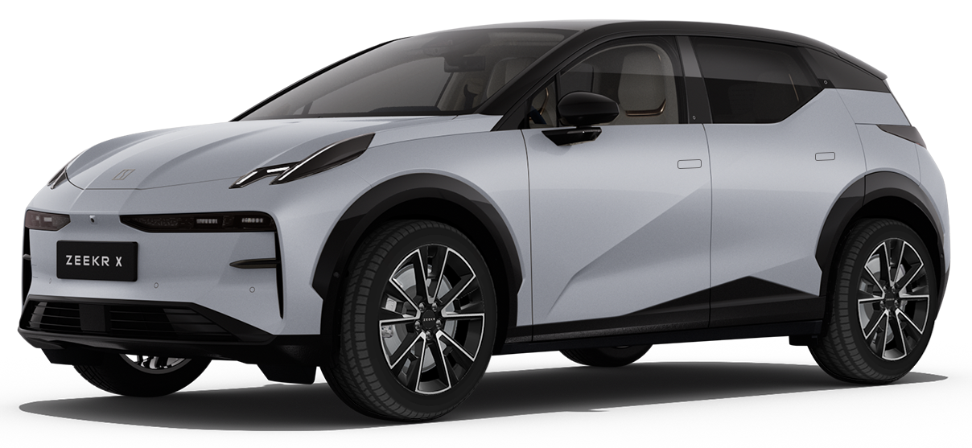
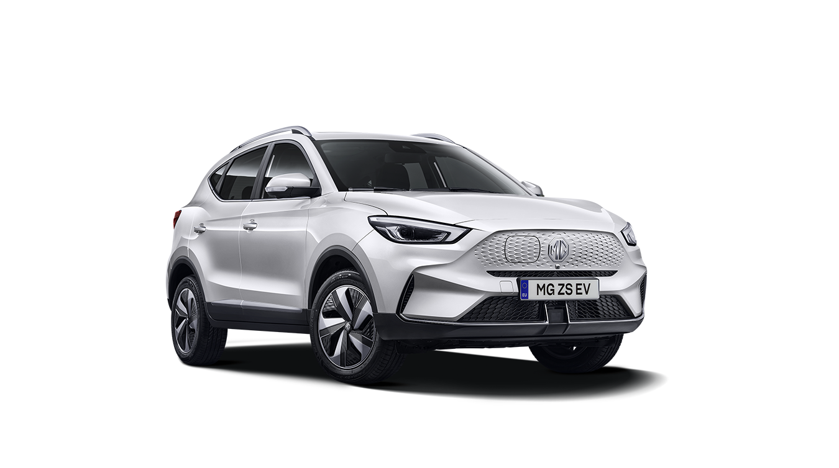
Atto 3 Potential EV Competitors in the C and B-SUV Segment.
Geometry - C
EV / RWD / Battery Capacity 53 kWh
Starting Price – AED 109,900 2024 Sales – 20 units
Atto 3 Comfort
EV / FWD / Battery Capacity 60.48 kWh
Price – AED 119,900 / SoS Sep 2024
Atto 3 Premium
EV / FWD / Battery Capacity 60.48 kWh
Price – AED 149,900
Zeekr X
EV / RWD / Battery Capacity 66 kWh
Starting Price – AED 170,900
2024 Sales – No Data
C-SUV EV Segment Price Ladder
MG ZS
EV / RWD / Battery Capacity 51 kWh
Starting Price – AED 139,000
2024 Sales – 11 units
Atto 3
Geometry C
Zeekr X
MG ZS
Source: Official Website, Prices incl 5% VAT

Slide 11
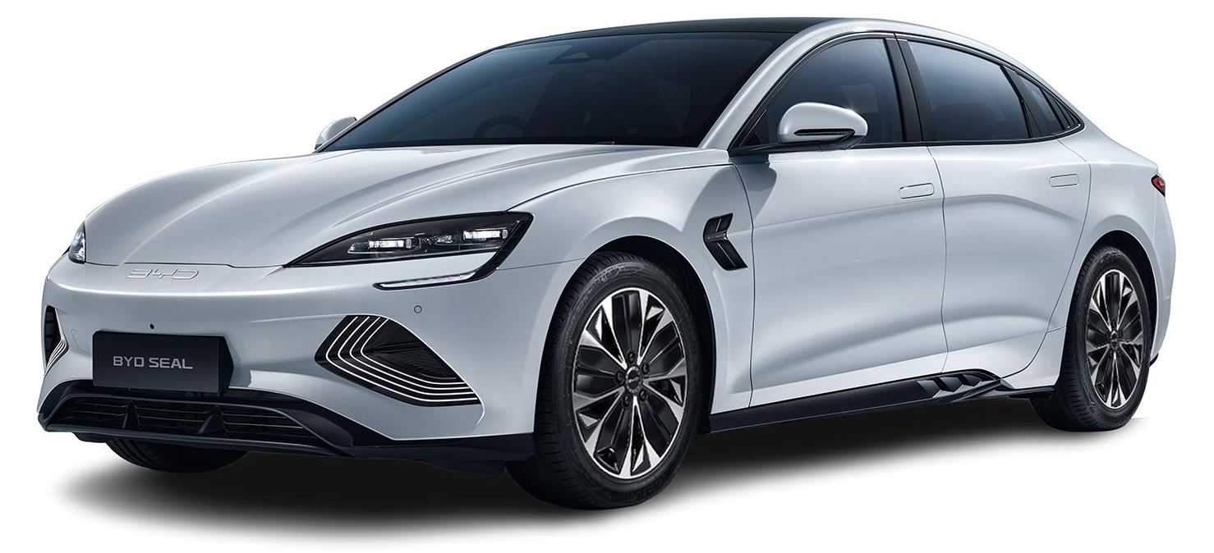
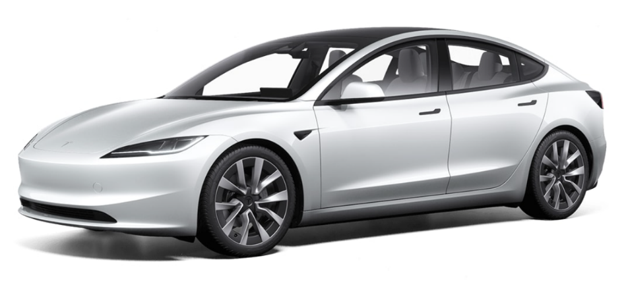
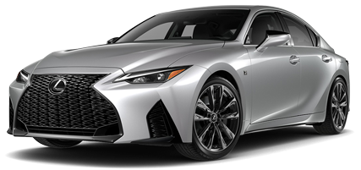
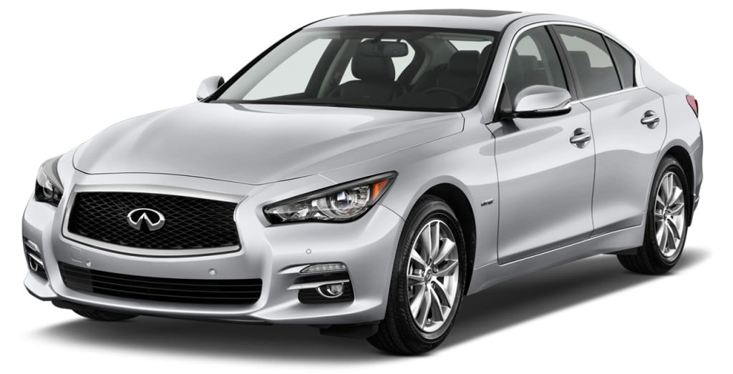
Seal main competitors in the D-Sedan Segment.
Model 3
BEV / RWD
Starting Price – AED 167,990 Market Share – 80%
Seal Design
EV / RWD / Battery Capacity 82.5 kWh
Price – AED 149,900 / SoS Q3 2024
Seal Premium
EV / RWD / Battery Capacity 82.5kWh
Price – AED 164,900 / SoS June 2024
Seal Performance
EV / AWD / Battery Capacity 82.5 kWh
Price – AED 194,900 / SoS April 2024
IS
ICE / FWD / 2.5L
Starting Price – 185,000 Market Share – 5%
D-Sedan Segment Price Ladder
Market Share
New Trim
IS
Q50
Performance
3%
Other
Q50
ICE / FWD / 1.8T
Starting Price – AED 153,000 Market Share – 3%
Model 3
Seal
Primary Surrogate
Model 3
IS
Q50
EV
Source: MEAC Report 2024, Prices incl 5% VAT

Slide 12
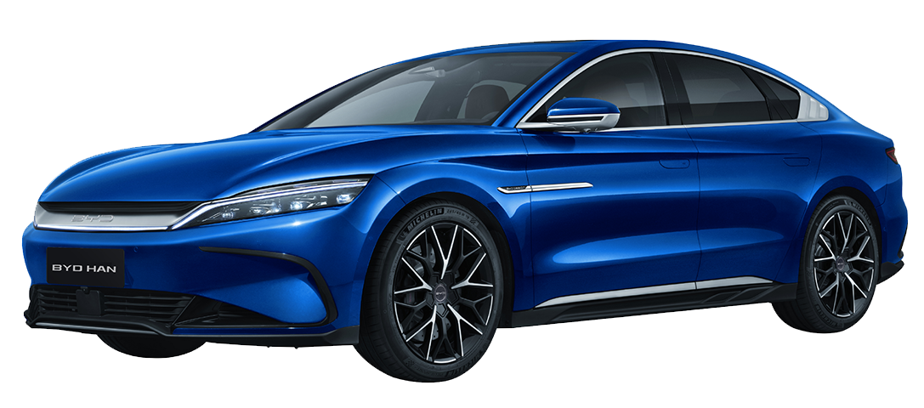
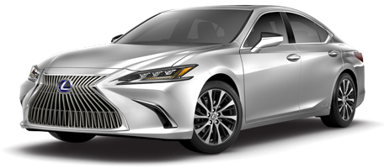
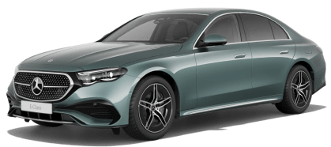
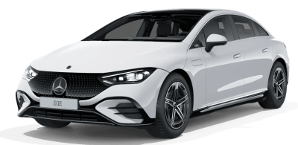
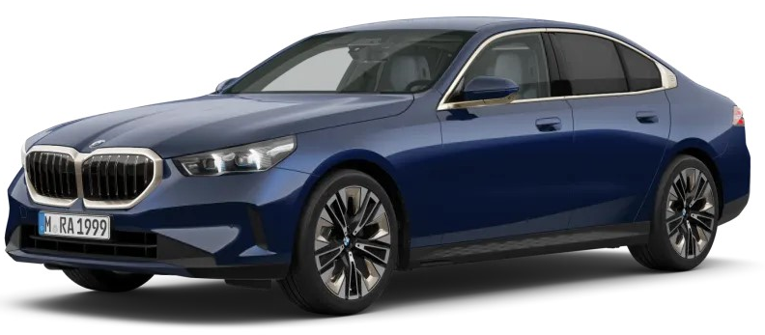
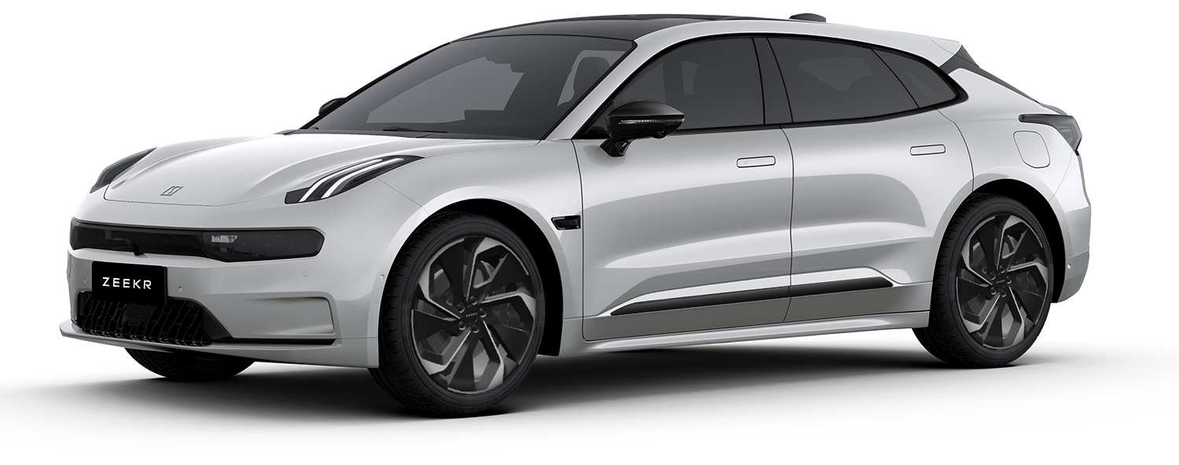
Han main competitors in the E-Sedan Segment.
ES HV
HEV / 2.5L
Starting Price – AED 225,000 Market Share – 33%
ES350
ICE / 3.5L
Starting Price – AED 215,000 Market Share – 9%
E - Class
ICE / RWD
Starting Price – AED 388,900 Market Share – 13%
Han Premium
EV / FWD / Battery Capacity 85.4 kWh
Price – AED 199,900 / SoS Oct 2024
Han Flagship
EV / AWD / Battery Capacity 85.4 kWh
Price – AED 231,900
E-Sedan Segment Price Ladder
Market Share
EQE
EV / RWD
Starting Price – AED 399,900 Market Share – 8%
AMG
AMG
Other
5-Series
ICE / RWD
Starting Price – AED 300,000 Market Share – 9%
350+
i5
ES
5-Series
EQE
Zeekr 001
EV / RWD
Starting Price – AED 226,900 Market Share – No Data
Han
ESh
ES350
E-Class
EQE
5-Series
Zeekr 001
E - Class
HEV
Primary Surrogate
Source: MEAC Report 2024, Prices incl 5% VAT

Slide 13
Expected Outcomes of Successful Objection Handling: Training isn’t just reading. Set practical
Key Takeaways
Focus on selling the value, not just the price.
Understand and empathize with the customer’s concerns.
Use effective techniques to turn objections into opportunities.
Final Tips for Success
More customers choosing Al Futtaim vehicles over competitors.
Enhanced Reputation for the Brand
Customers perceive Al Futtaim as a value-driven and customer-focused brand.
Building Stronger Customer Relationships
Trust and satisfaction lead to long-term loyalty.
Increased Conversion Rates
More customers choosing Al Futtaim vehicles over competitors.
Enhanced Reputation for the Brand
Customers perceive Al Futtaim as a value-driven and customer-focused brand.

Slide 14
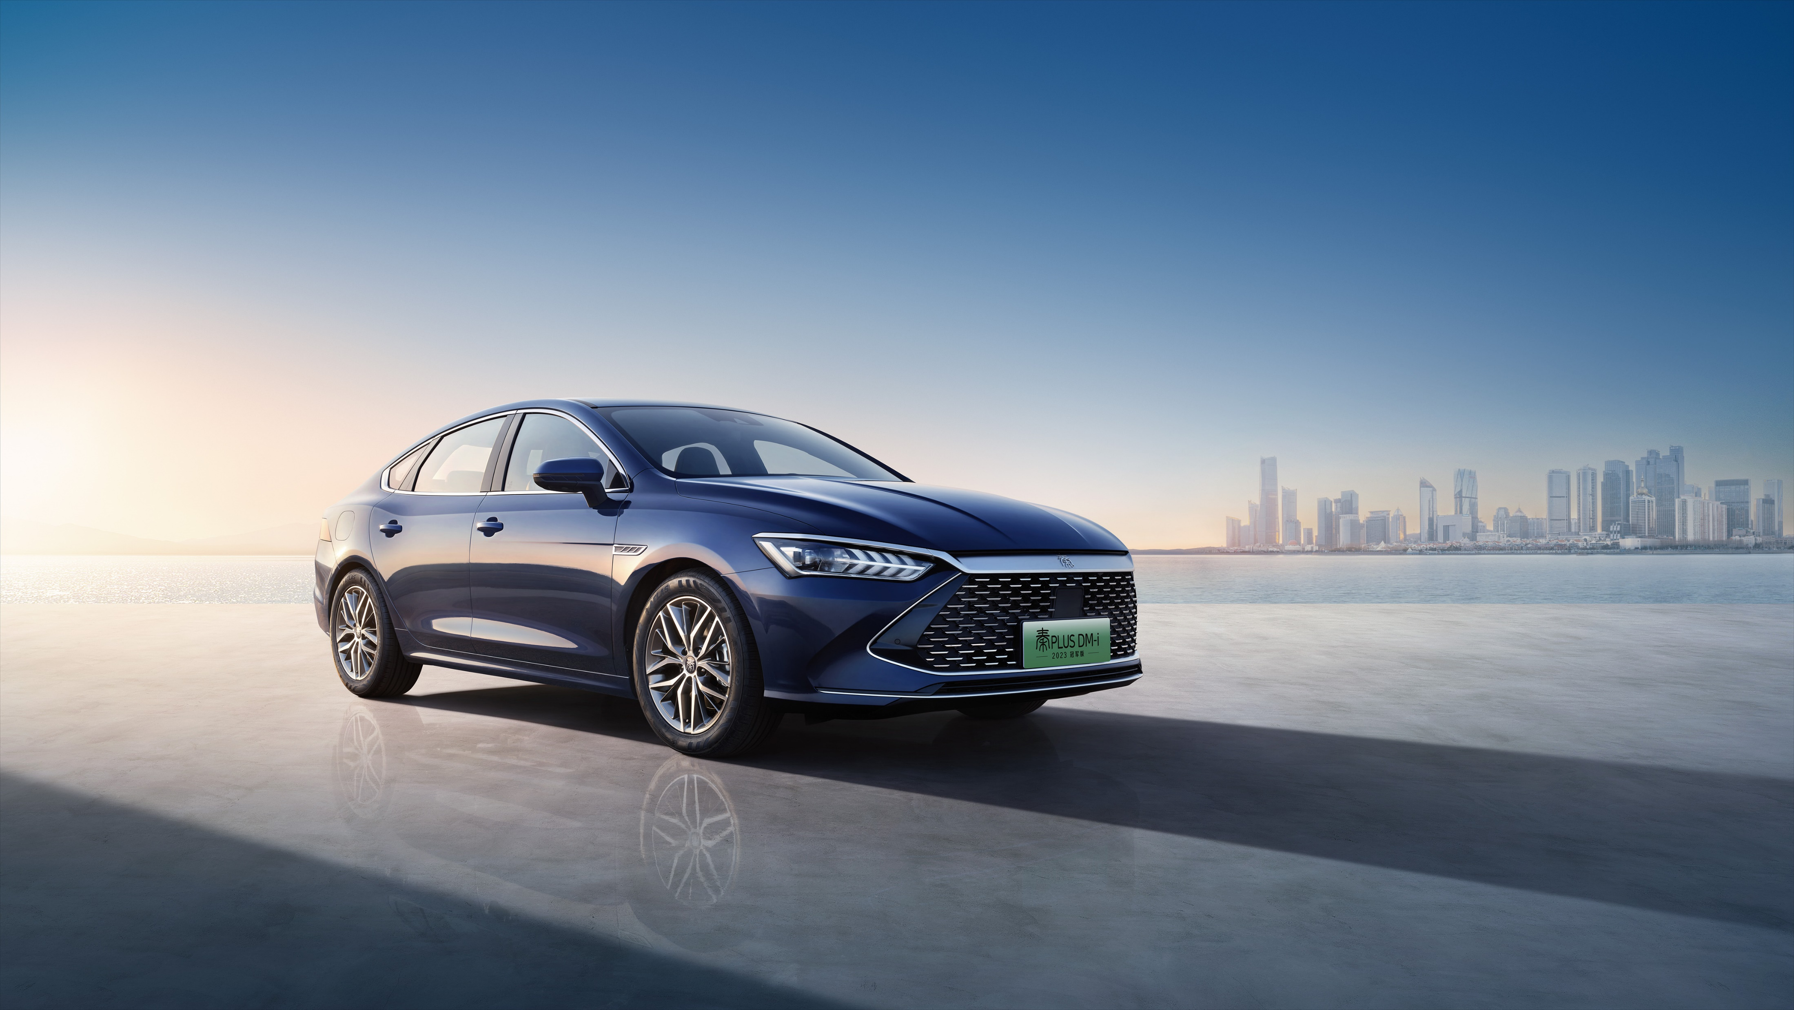
Thank you!

